Slide 1
CMPE 272 – ENTERPRISE SOFTWARE PLATFORMS TIRE PRESSURE MONITORING SYSTEM
UNDER
PROF. RAKESH RANJAN

Slide 2
TEAM - 1
TEAM MEMBER | SJSU ID
DISHA SHETH | 011498240
HARSH MEHTA | 011429912
BHAVAN PANDYA | 011456991
AISHWARYA KEERTY | 011091574

Slide 3
PROJECT ABSTRACT
A Tire Pressure Monitoring System monitors the air pressure in a vehicle and warns the user when one or more tires are under – inflated which creates unsafe driving conditions.
The US government passed the Transportation Recall Enhancement, Accountability, and Documentation (TREAD) Act which mandates that every vehicle sold in United States Since 2007 must include a TPMS of some sort.

Slide 4
ADVANTAGES OF DIRECT TPMS
Direct TPMS uses pressure monitoring sensors within each tire that monitor specific pressure levels unlike indirect TPMS which depends on the anti-lock brake system of the vehicle.
Delivers the actual tire pressure readings from inside the tire.
Can be included in vehicles spare tire.
Not prone to inaccuracies.
The battery in Direct TPMS lasts a long time.

Slide 5
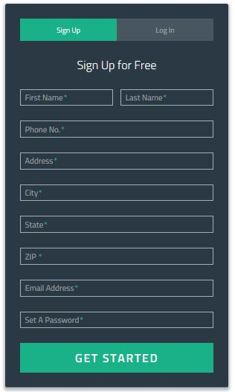
ON THE WEBSITE-SIGNUP

Slide 6
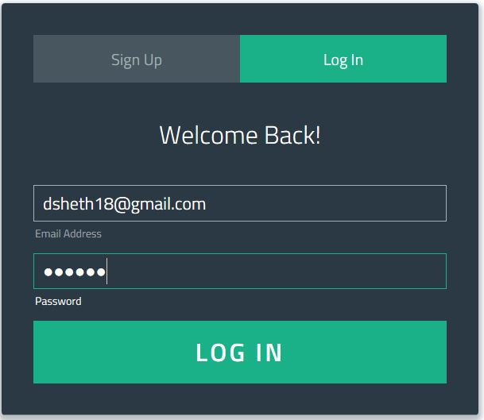
ON THE WEBSITE-LOGIN

Slide 7
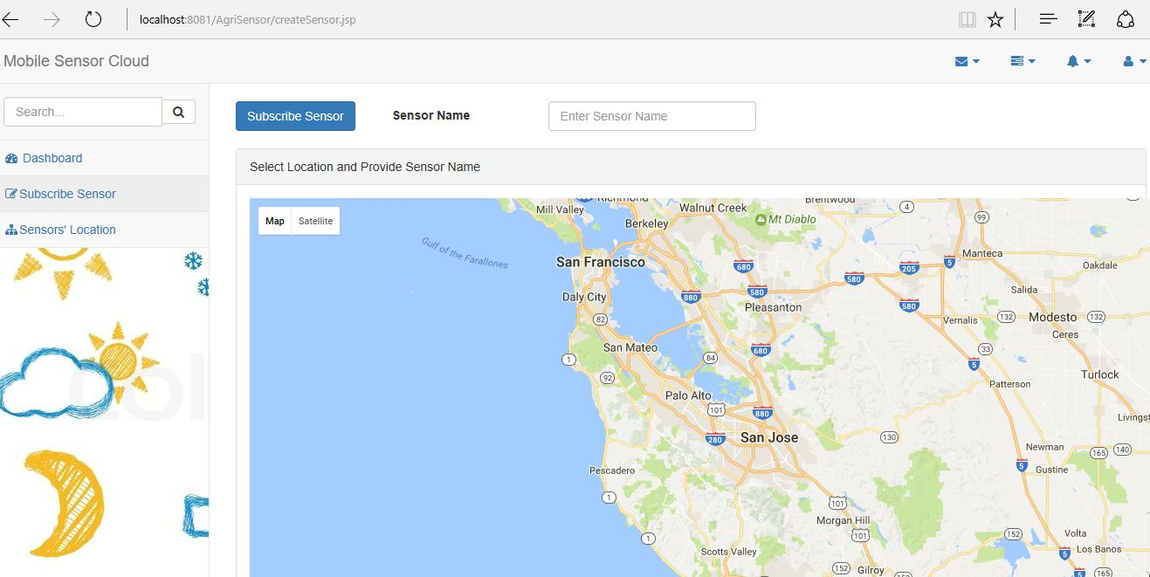
SUBSCRIBE TO SENSORS

Slide 8
SUBSCRIBE TO SENSORS
On subscribing to a sensor, that particular sensor gets attached to the corresponding user.
The corresponding data is then visible to the user on his android app.
If the sensor delivers data below or above a certain level i.e. the tire is underinflated or overinflated, notification is pushed to the user as an alert.

Slide 9
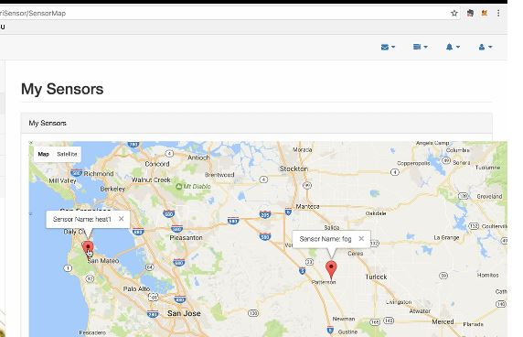
SENSOR’S LOCATION

Slide 10

LOGIN FOR ANDROID APPLICATION

Slide 11
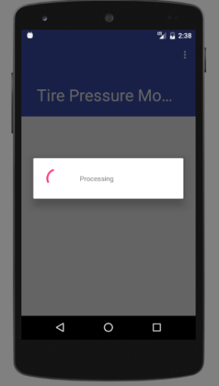
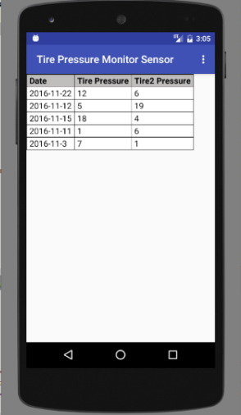
SENSOR DATA HISTORY OF PAST 5 DAYS

Slide 12
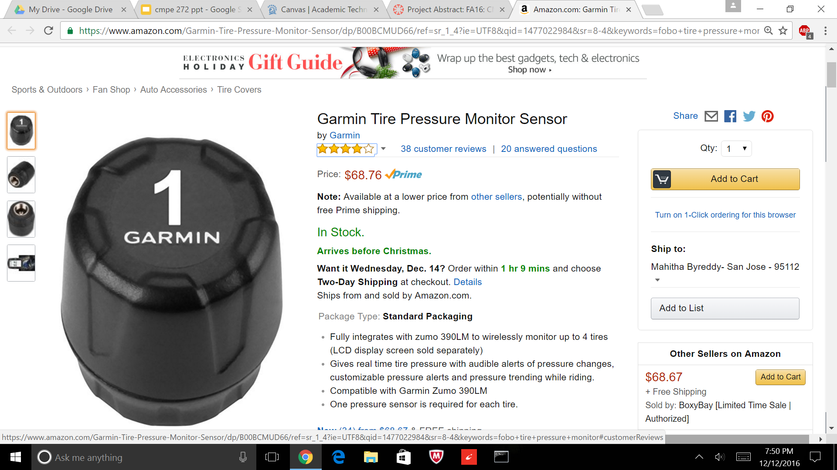
MARKET ANALYSIS

Slide 13
MARKET ANALYSIS
Garmin tool available in market costs nearly $70. Also, it requires a display to be installed in the car itself. As a set, it costs nearly $150.
When developed using tire pressure sensors and cloud, the total budget comes to around $55.
This shows that it is far more cheaper compared to its market competitor and is a budget-product for consumers.

